Slide 1
Sustainable Development Goals (SDGs)

Slide 2
History
IN 2015, LEADERS FROM 193 COUNTRIES OF THE WORLD CAME TOGETHER TO FACE THE FUTURE.
They saw famines, drought, wars, plagues and poverty; not just in some faraway place, but in their own cities and towns and villages.
They knew we had enough food to feed the world, but that it wasn’t getting shared.
They knew there were medicines for HIV and other diseases, but they cost a lot.
They knew that earthquakes and floods were inevitable, but that the high death tolls were not.
They also knew that billions of people worldwide shared their hope for a better future.

Slide 3
History
So leaders from these countries created a plan called the Sustainable Development Goals (SDGs).
This set of 17 goals imagines a future just 15 years off that would be rid of poverty and hunger, and safe from the worst effects of climate change. It’s an ambitious plan.
But Can we succeed?
There is ample evidence that we can succeed. In the past 15 years, the international community cut extreme poverty in half.
Now they wanted to finish the job.

Slide 4
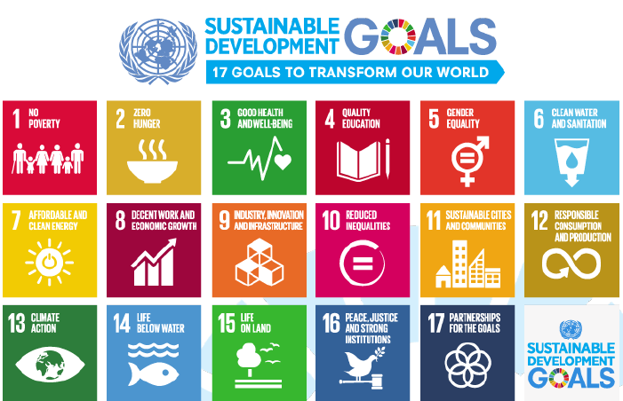

Slide 5
The SDGs are …
A set of 17 goals for the world’s future, through 2030
Backed up by a set of 169 detailed Targets
Negotiated over a two-year period at the United Nations
Agreed to by nearly all the world’s nations, on 25 Sept 2015

Slide 6
What is new and different about the 17 SDGs?
First, and most important, these Goals apply to every nation … and every sector. Cities, businesses, schools, organizations, all are challenged to act. This is called
Universality

Slide 7
Second, it is recognized that the Goals are all inter-connected, in a system. We cannot aim to achieve just one Goal. We must achieve them all. This is called
Integration

Slide 8
And finally, it is widely recognized that achieving these Goals involves making very big, fundamental changes in how we live on Earth. This is called
Transformation

Slide 9
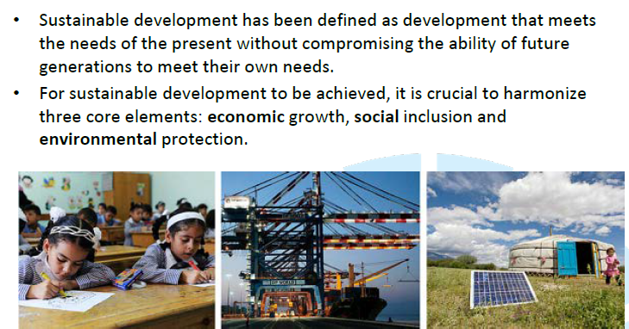
Three dimensions of sustainable development

Slide 10
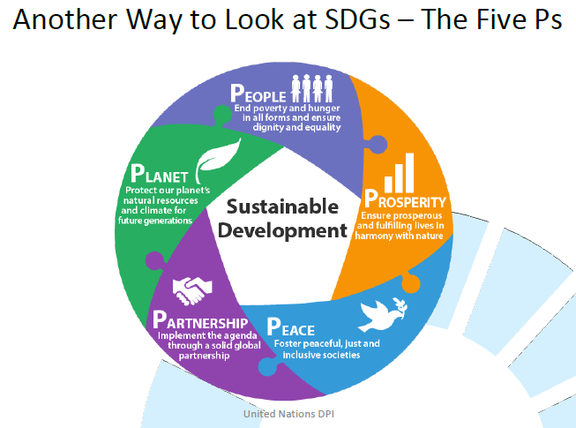

Slide 11
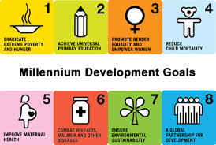
Sustainable Development Goals
Over the next 15 years, these new Goals will universally apply as part of the 2030 Agenda for Sustainable Development
Countries will mobilize efforts to end all forms of poverty, fight inequalities and tackle climate change
SDG’s aim to build on the successes of the MDGs

Slide 12

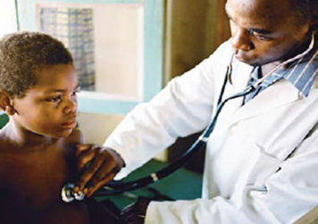







Millennium Development Goals (MDGs)
8 Goals adopted by 150 Heads of State in 2000 to be achieved by 2015
End Poverty and Hunger
Universal Education
Gender Equality
Reduce child deaths
Improve Maternal Health
Combat HIV/AIDS, Malaria and other diseases
Ensure environmental sustainability
Improve a global partnership for development

Slide 13
Outcomes of MDGs
Greatest achievement of MDGs was to mobilize broad
support for a global development agenda
Raised one billion people out of extreme poverty
Quantifiable targets and a baseline
Urgency through deadline (2015)
Greater financial investments and resources mobilized
Innovative partnerships
Galvanized public opinion

Slide 14
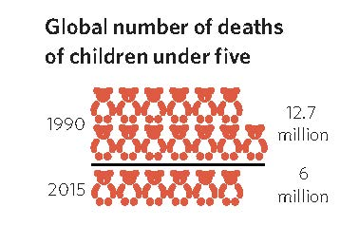
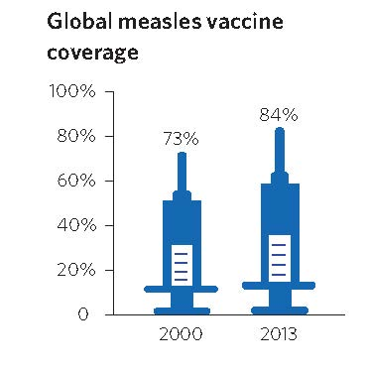
Progress in Health
Goal 4: Reduce child deaths
Under five mortality 50% decline
between 1990- 2015
Measles
Cases declined 67% between 2000 and 2013
measles vaccination helped prevent
nearly 15.6 million deaths

Slide 15
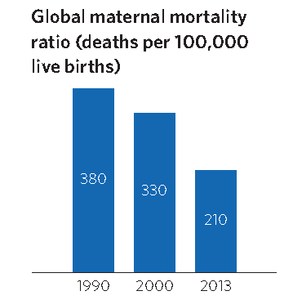
Goal 5: Improve maternal health
Maternal Mortality Ratio declined by 45 %
More than 71 % of births were
assisted by skilled health personnel in
2014 an increase from 59 % in 1990
Contraceptive prevalence among women aged 15 to 49 increased from 55 % in 1990 worldwide to 64 % in 2015

Slide 16
Goal 6: Combat HIV/AIDS, malaria and other diseases
New HIV infections fell by approximately 40 % between 2000 and 2013 from an estimated 3.5 million cases to 2.1 million
By June 2014, 13.6 million people living with HIV were receiving ART globally, an increase from 800,000 in 2003
ART averted 7.6 million deaths from AIDS between 1995 and 2013

Slide 17
Goal 6: Combat HIV/AIDS, malaria and other diseases
Malaria deaths - 58% reduction between 2000 – 2015
6.2 million deaths averted
Over 37 million lives saved
More than 900 million insecticide-treated mosquito nets were delivered to malaria-endemic countries in sub-Saharan Africa between 2004 and 2014
The tuberculosis prevalence rate fell by 41 % and the mortality rate fell by 45 % between 1990 and 2013
Between 2000 and 2013, tuberculosis prevention, diagnosis and treatment saved an estimated 37 million lives

Slide 18

What next?

Slide 19
Transitioning from MDGs to SDGs

Slide 20
Lessons Learned MDGs vs SDGs
MDGs
UN agencies-led process
Driven by small group of experts
Developing country focus: poverty reduction and social development
8 Goals - 3 for health
21 Targets - 6 for health
SDGs
Intergovernmental process
UN in technical advisory role
Highly collaborative process involving all stakeholders
All-country focus: economic, social and environmental pillars of development
17 Goals - 1 for health
169 Targets - 13 for health

Slide 21

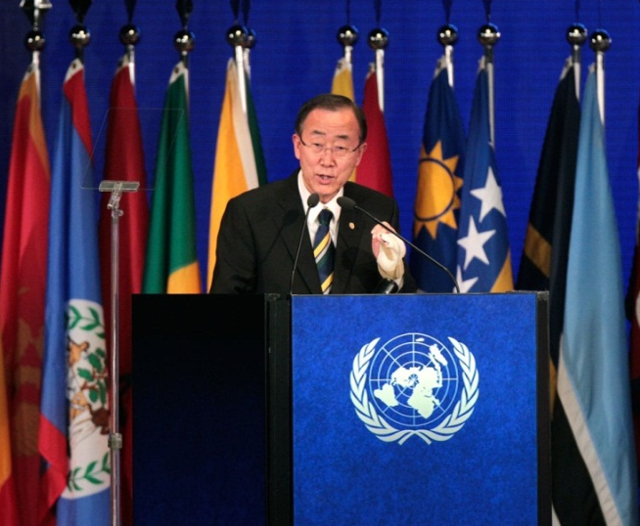
Milestones in the development of SDGs and Post 2015 agenda
June 2012 : SDGs first formally discusses at the UN Conference on Sustainable Development held in Rio de Janeiro (Rio+20).
July 2012 : UN SG Ban Ki-Moon appoints 26 public and private leaders to advise him on the post-MDG agenda.
Jan 2013: A 30-member Open Working Group (OWG) on SDGs, established by the UN General Assembly to prepare a proposal on the SDGs.
July 2014: UN General Assembly’s Open Working Group forwards a proposal for the SDGs to the Assembly (17 goals and 169 targets).
Photo: REUTERS

Slide 22
Milestones in the development of SDGs
Dec 2014: UN General Assembly accepts the SG’s Synthesis Report which states that the SDGs will be based on the OWG proposals.
Jan 2015: Member states officially began intergovernmental negotiations in the UN General Assembly on the Post-2015 Development Agenda.
September 2015: SDGs adopted by 150 Member States at historic UN Summit in New York
January 2016: SDGs enter into force

Slide 23

Transformative vision
In September 2015 Ban Ki Moon hails the SDGs as a universal, integrated and transformative vision for a better world
“The new agenda is a promise by leaders to all people everywhere. It is an agenda for people, to end poverty in all its forms – an agenda for the planet, our common home.”

Slide 24
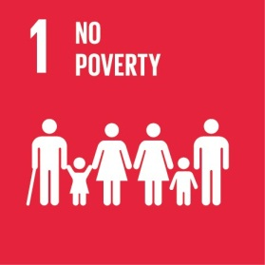
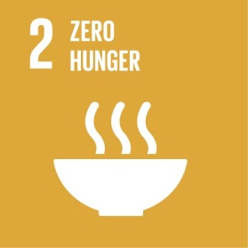



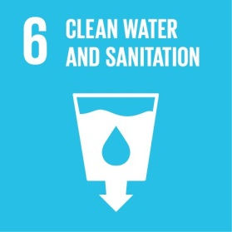
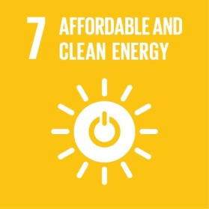
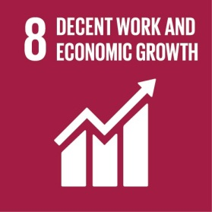

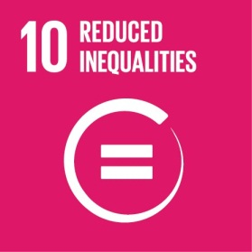
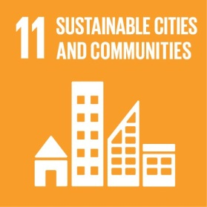
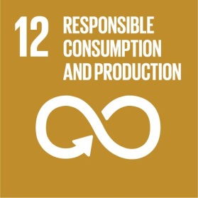
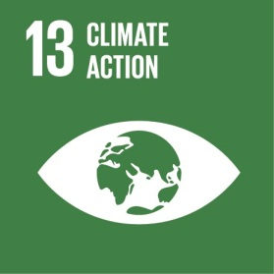
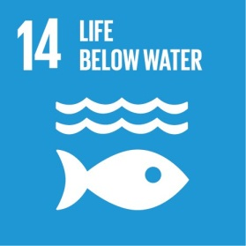
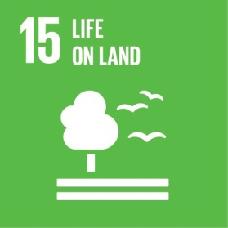

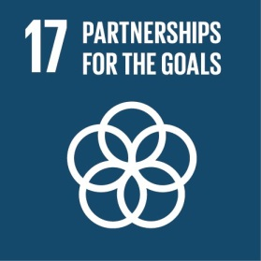
17 Goals with 169 indicators

Slide 25
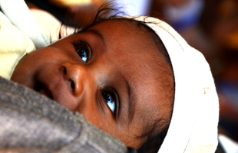
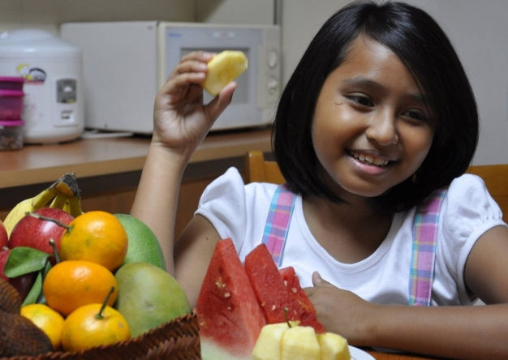
Goal 3: Ensure healthy lives and promote well-being for all at all ages
One goal with 13 targets

Slide 26
Health Targets by 2030
1. Reduce global maternal mortality ratio to
less than 70 per 100,000 live births
2. End preventable deaths of newborns and children
under 5 years of age
3. End the epidemics of AIDS, tuberculosis, malaria and NTDs, combat hepatitis, water borne diseases and other communicable diseases
4. Reduce by 1/3 premature mortality from NCDs
5. Strengthen prevention and treatment of substance abuse including drugs and alcohol

Slide 27
Health Targets
6. Halve number of deaths and injuries from road traffic accidents
7. Ensure universal access to sexual and reproductive health-care services
8. Achieve universal health coverage
9. Reduce deaths and illnesses due to pollution and contamination

Slide 28

Health Targets
10. Strengthen implementation of WHO
Framework Convention on Tobacco Control
11. Support research and development of vaccines and medicines and provide access to affordable essential medicines and vaccines
12. Increase health financing and the health workforce
13. Strengthen early warning systems, risk reduction and management of national and global health risks

Slide 29
Goal 2: End hunger, achieve food security and improved nutrition Target 2.2: end malnutrition, achieve targets for reductions child stunting and wasting
Health is linked to many other SDGs
Goal 1: End poverty
Target 1.3: Implement social protection systems for all
Goal 6: Ensure availability and sustainable management of water and sanitation for all
Target 6.1: achieve universal and equitable access to safe and affordable drinking water
Health
Goal 4: Ensure inclusive and equitable education
Target 4.2: ensure access to early childhood development, care and pre-primary education
Goal 5: Achieve gender equality and empower all women and girls Target 5.2: end all forms of violence against all women and girls
Goal 16: Promote peaceful and inclusive societies for sustainable development Target 16.1: reduce all forms of violence and related death rates everywhere
Other goals and targets e.g. Goal 10 inequality, 11 cities, 13 climate change

Slide 30
Health in SDGs
Health given high priority
Goal is ‘to ensure healthy lives and promote well-being at all ages’
Broader agenda than with MDG health goals
Health will be influenced by many other SDGs
The SDG agenda includes a broader range of determinants of health -poverty reduction, reducing inequality, climate action, migration
Bringing it together: Universal Health Coverage
Declaration states “to promote physical and mental health and well being and to extend life expectancy for all we must achieve universal health coverage and access to quality health care. No-one must be left behind.”

Slide 31
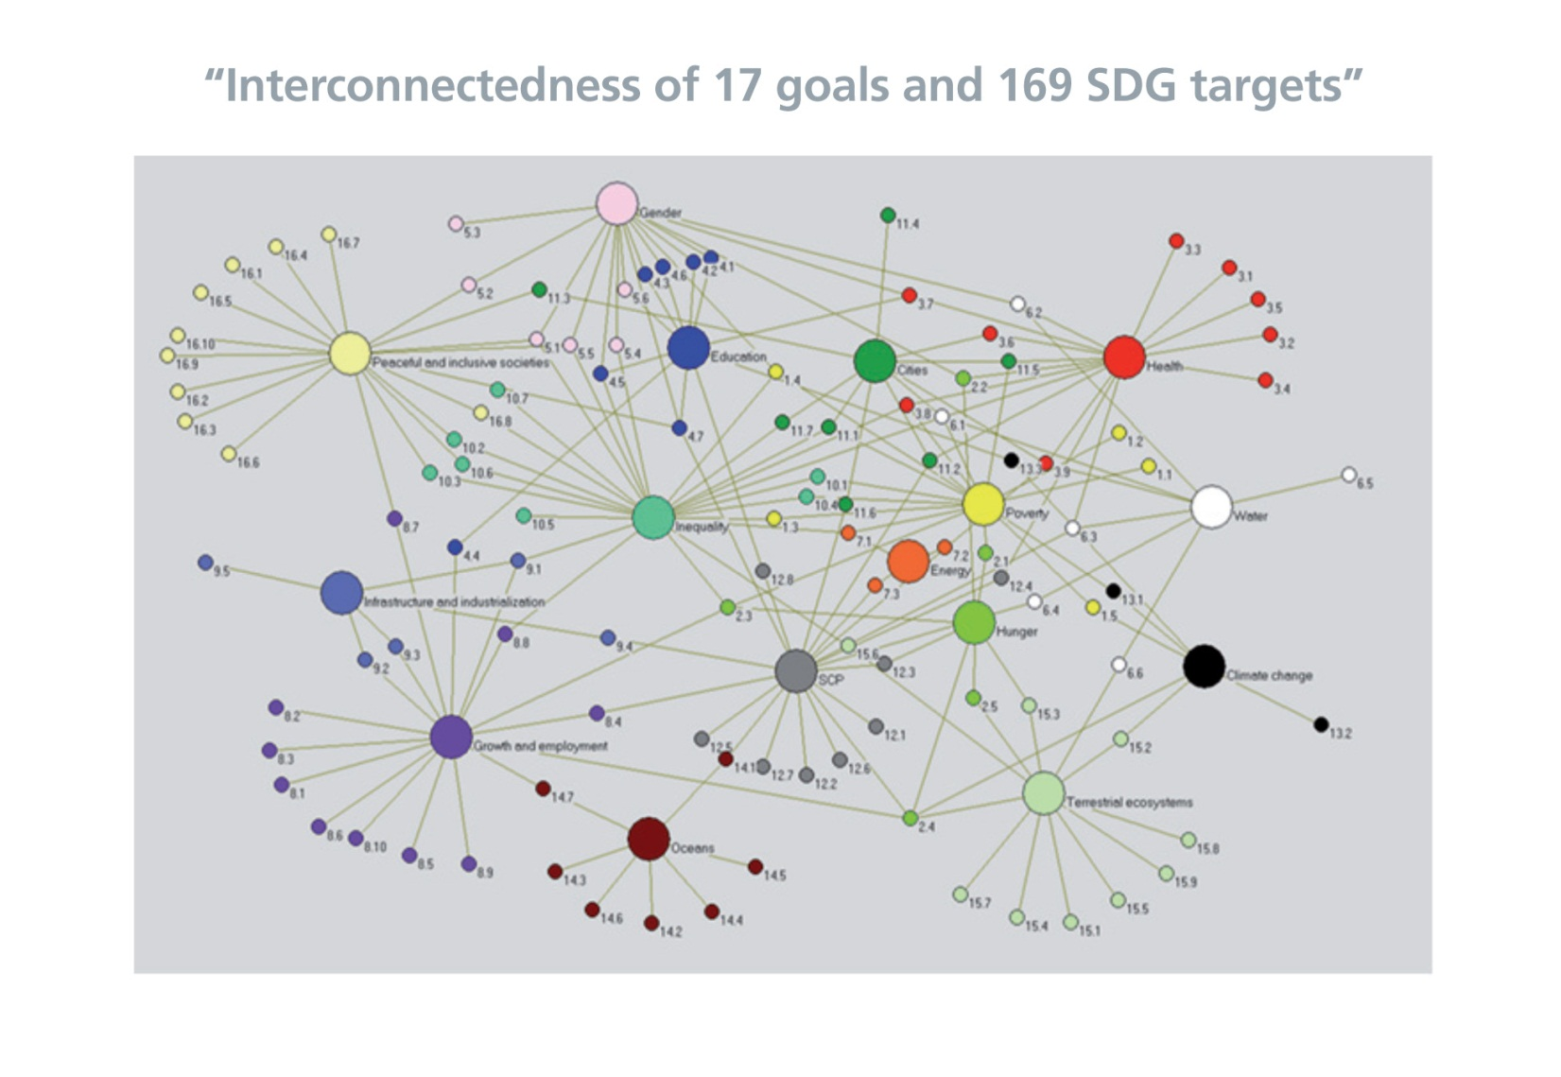
Interconnectedness

Slide 32
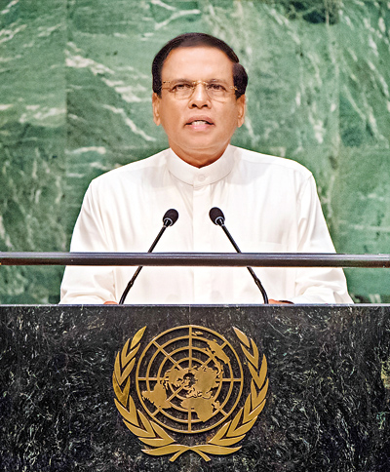
Sri Lanka’s commitment to SDGs
President Sirisena pledged the full support of the Government of Sri Lanka to the Post-2015 Sustainable Development Agenda and pursuance of 17 Sustainable Development Goals (SDG) to be completed by 2030
President Sirisena addressing the UN’s Sustainable Development Summit,
September 2015

Slide 33



Take action!
Things you can do at home
Save electricity
Turn off lights and appliances when not in use – including computers
Save paper and trees
Stop paper bank statements and pay your
bills online
Don’t print - use digital post-its or write down a note
instead
Speak up!
Ask your local and national authorities to engage in
initiatives that don’t harm people or the planet

Slide 34



Take action!
Share – don’t just like
If you see something online about climate change or
women’s rights - share it so all your network can see
Buy local
Support local businesses and buy food produced locally
Shop smart
Plan meals, avoid food waste, save money
buy from ethical companies which have sustainable practices and don’t harm the environment

Slide 35



Take action!
Reduce, Recycle, Re-use, Refill
Take your own reusable shopping bag to the supermarket,
avoid plastic bags, use a refillable water bottle and coffee cup
Cut down on waste

